Slide 1


KAZAEROPROJECT
Republic of Kazakhstan,
Almaty, Sh.Kaldayakov st, 21, 050002
Phone: +7 (727) 382-40-02,
Fax: +7 (727) 382-39-92
www.airproject.kz, e-mail: info@airproject.kz
JOINT-STOCK COMPANY
DESIGN, RESEARCH, SINCE and SURVEY INSTITUTE

Slide 2

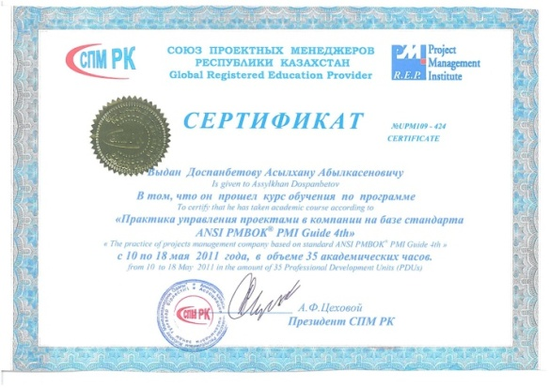
ABOUT COMPANY
Kazakh state design, research, since and survey institute founded in 1972
"Kazaeroproject" has a I-category license to design objects with high level of responsibility
"Kazaeroproject" licensed to perform geotechnical and topographic surveying
Developed more than 1,700 projects of varying complexity
Project activities of "Kazaeroproject" certified by ST RK ISO 9001-2009
Member of the "Association of designers of Kazakhstan"
KAZAEROPROJECT

Slide 3
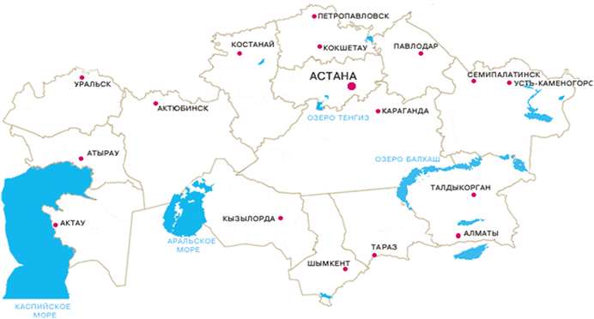
WORKS GEOGRAPHY
КЫРГЫЗСТАН
УЗБЕКИСТАН
ТАДЖИКИСТАН
KAZAEROPROJECT

Slide 4
PROJECT ACTIVITIES
AIRPORT GROUND INFRASTRUCTURE
COMMERCIAL ANS SOCIAL FACILITIES
GROUND TRANSPORT INFRASTUCTURE OBJECTS
Elaboration of airports perspective development programs
Predesign works
Design of airports, aerodromes, airfields and helipads
Development of airport master plans
Design of air terminal complexes
Design of air traffic control, navigation, communications, lighting equipment and security facilities
Designing of residential, administrative and industrial buildings
Design of automobile roads of all categories
Design engineering services
Engineering survey (surveying and geotechnical works)
KAZAEROPROJECT

Slide 5
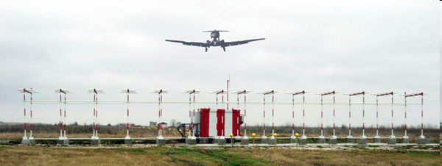
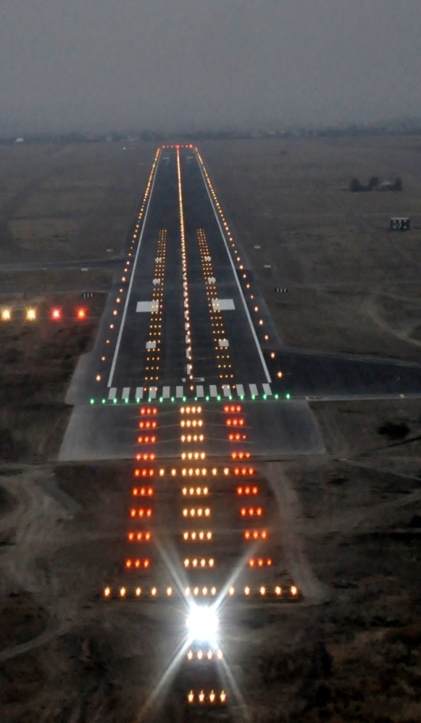
PROJECT ACTIVITIES
RADIO AIDS OF LANDING AND AERONAVIGATION
WEATHER TERMINAL EQUIPMENT
LIGHTING TERMINAL EQUIPMENT
KAZAEROPROJECT

Slide 6
PROJECTS
AERO TERMINAL KOMPLEXES
AIR TRAFFIC CONTROL BUILDINGS
KAZAEROPROJECT

Slide 7
PROJECTS
«BAYTEREK» MONUMENT IN ASTANA
29 LEVEL RESIDENTIAL BUILDING IN ASTANA
«SAMIRUK» CINEMA IN ASTANA
ADMINISTRATIVE BUILDING IN ASTANA
KAZAEROPROJECT

Slide 8
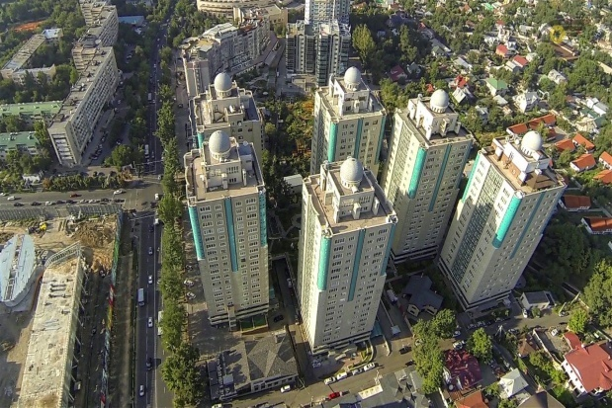
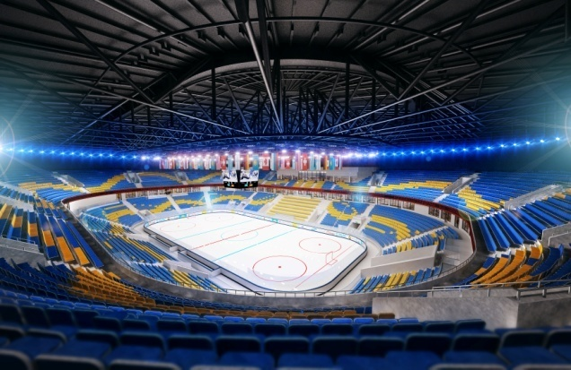
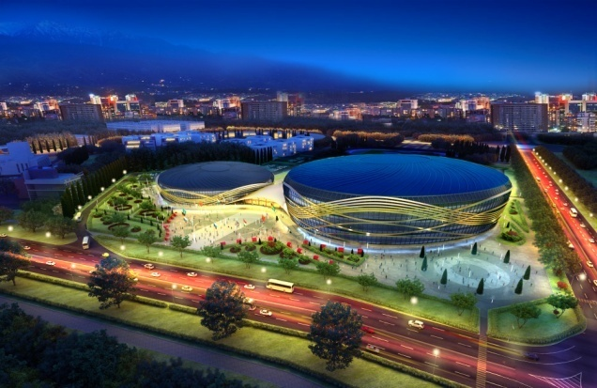
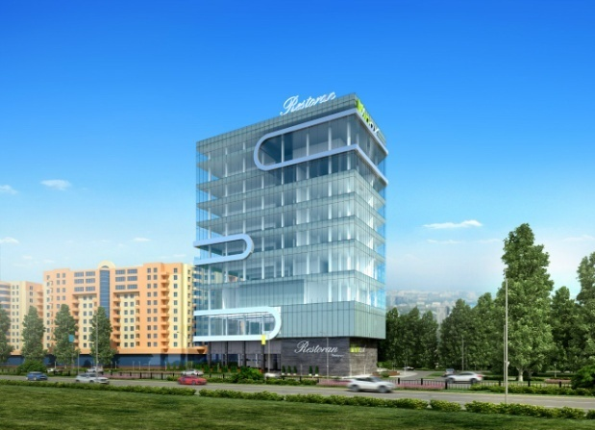
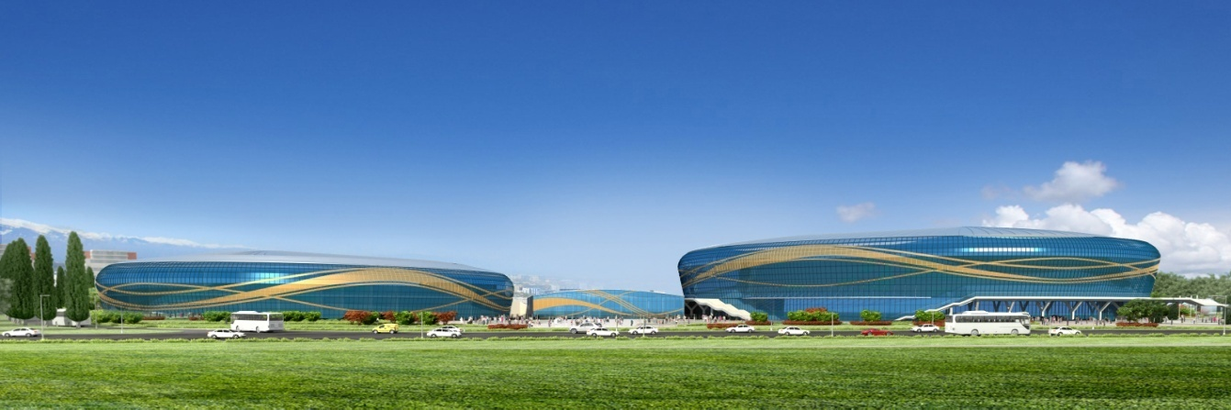
PROJECTS
«DOSTYK» RESIDENTIAL COMPLEX IN ALMATY
ICE ARENA FOR 12 000 AUDIENCE IN ALMATY
MULTYFUNCTIONAL COMPLEX IN ALMATY
KAZAEROPROJECT

Slide 9
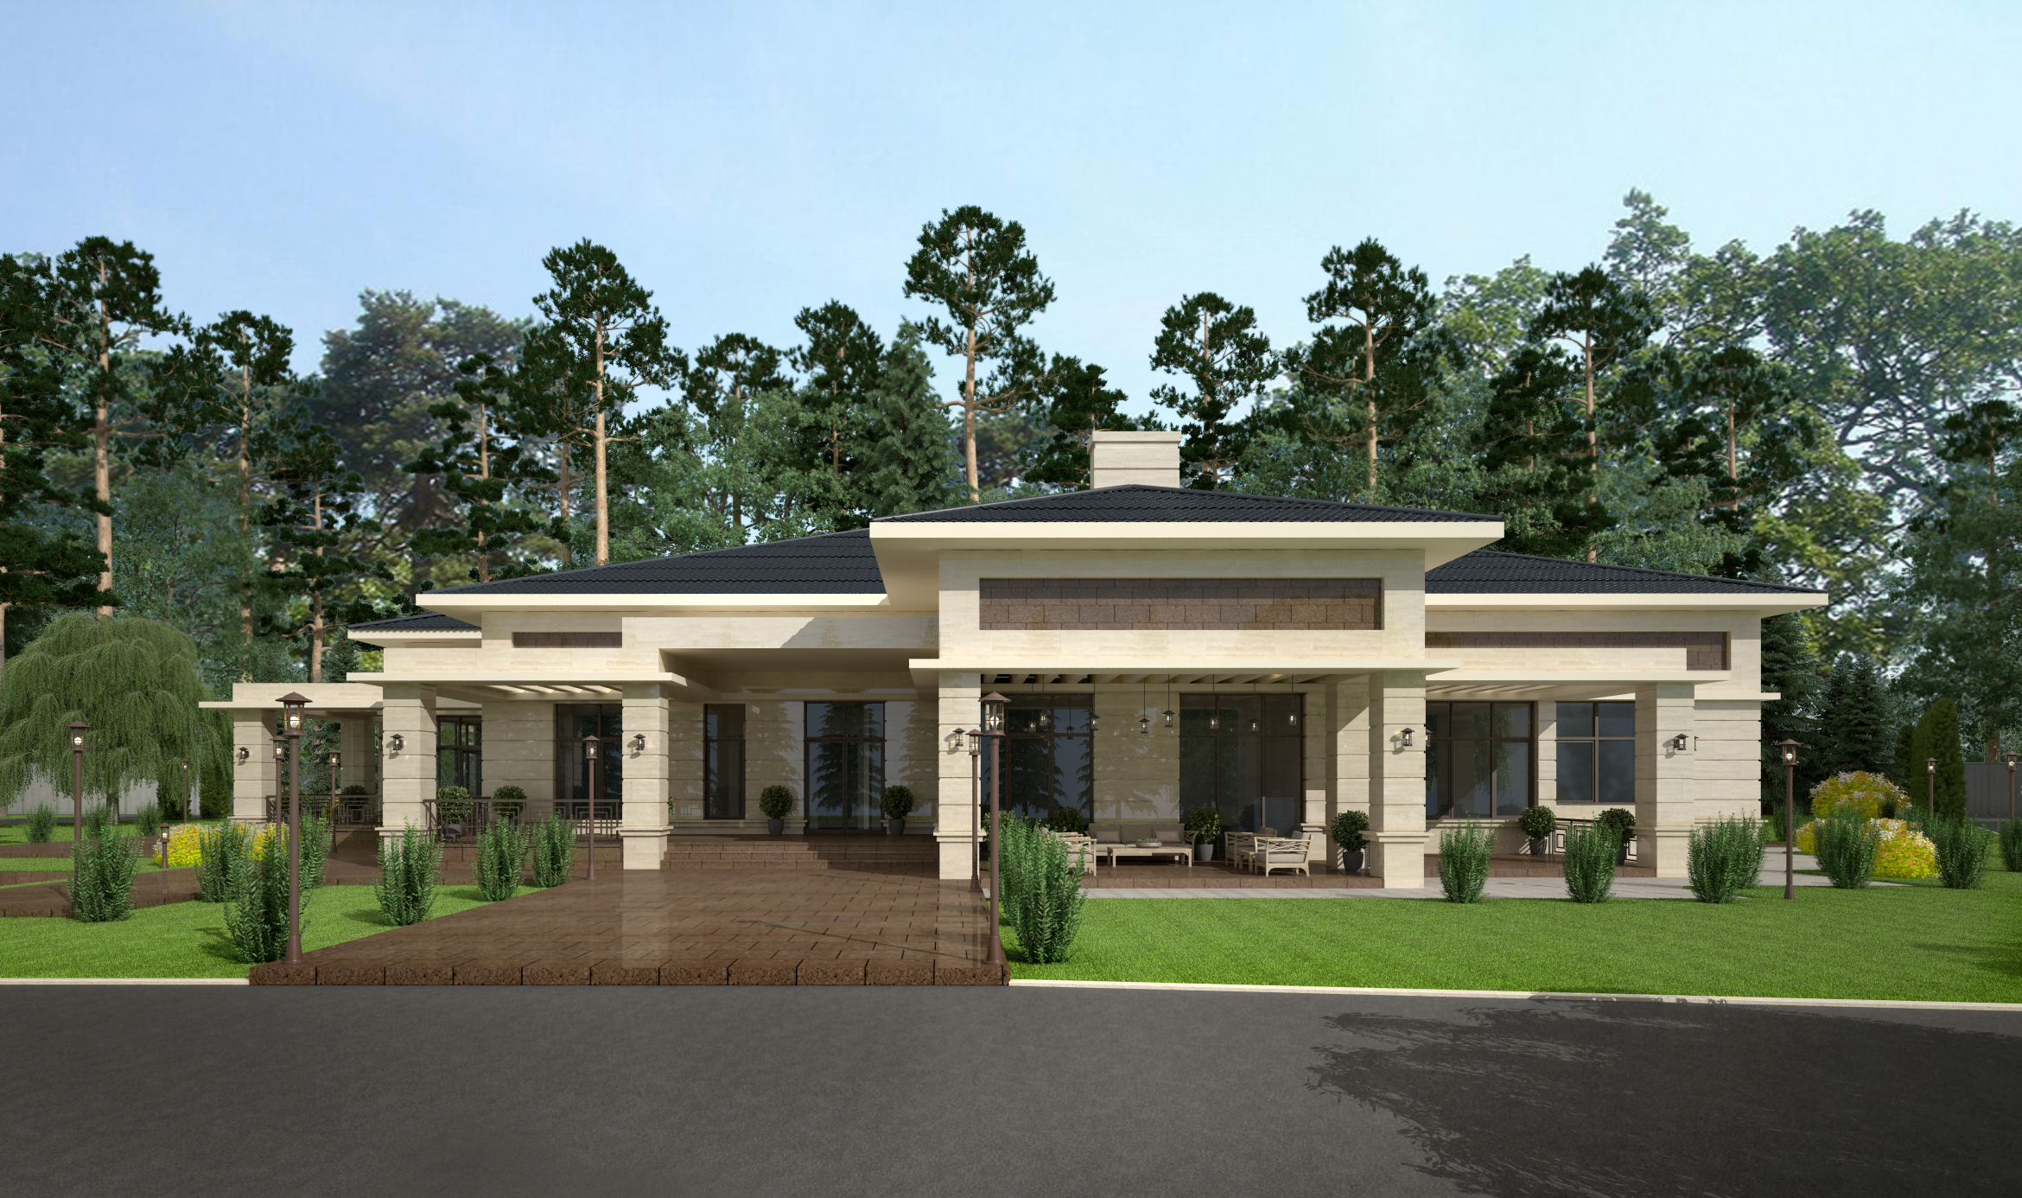
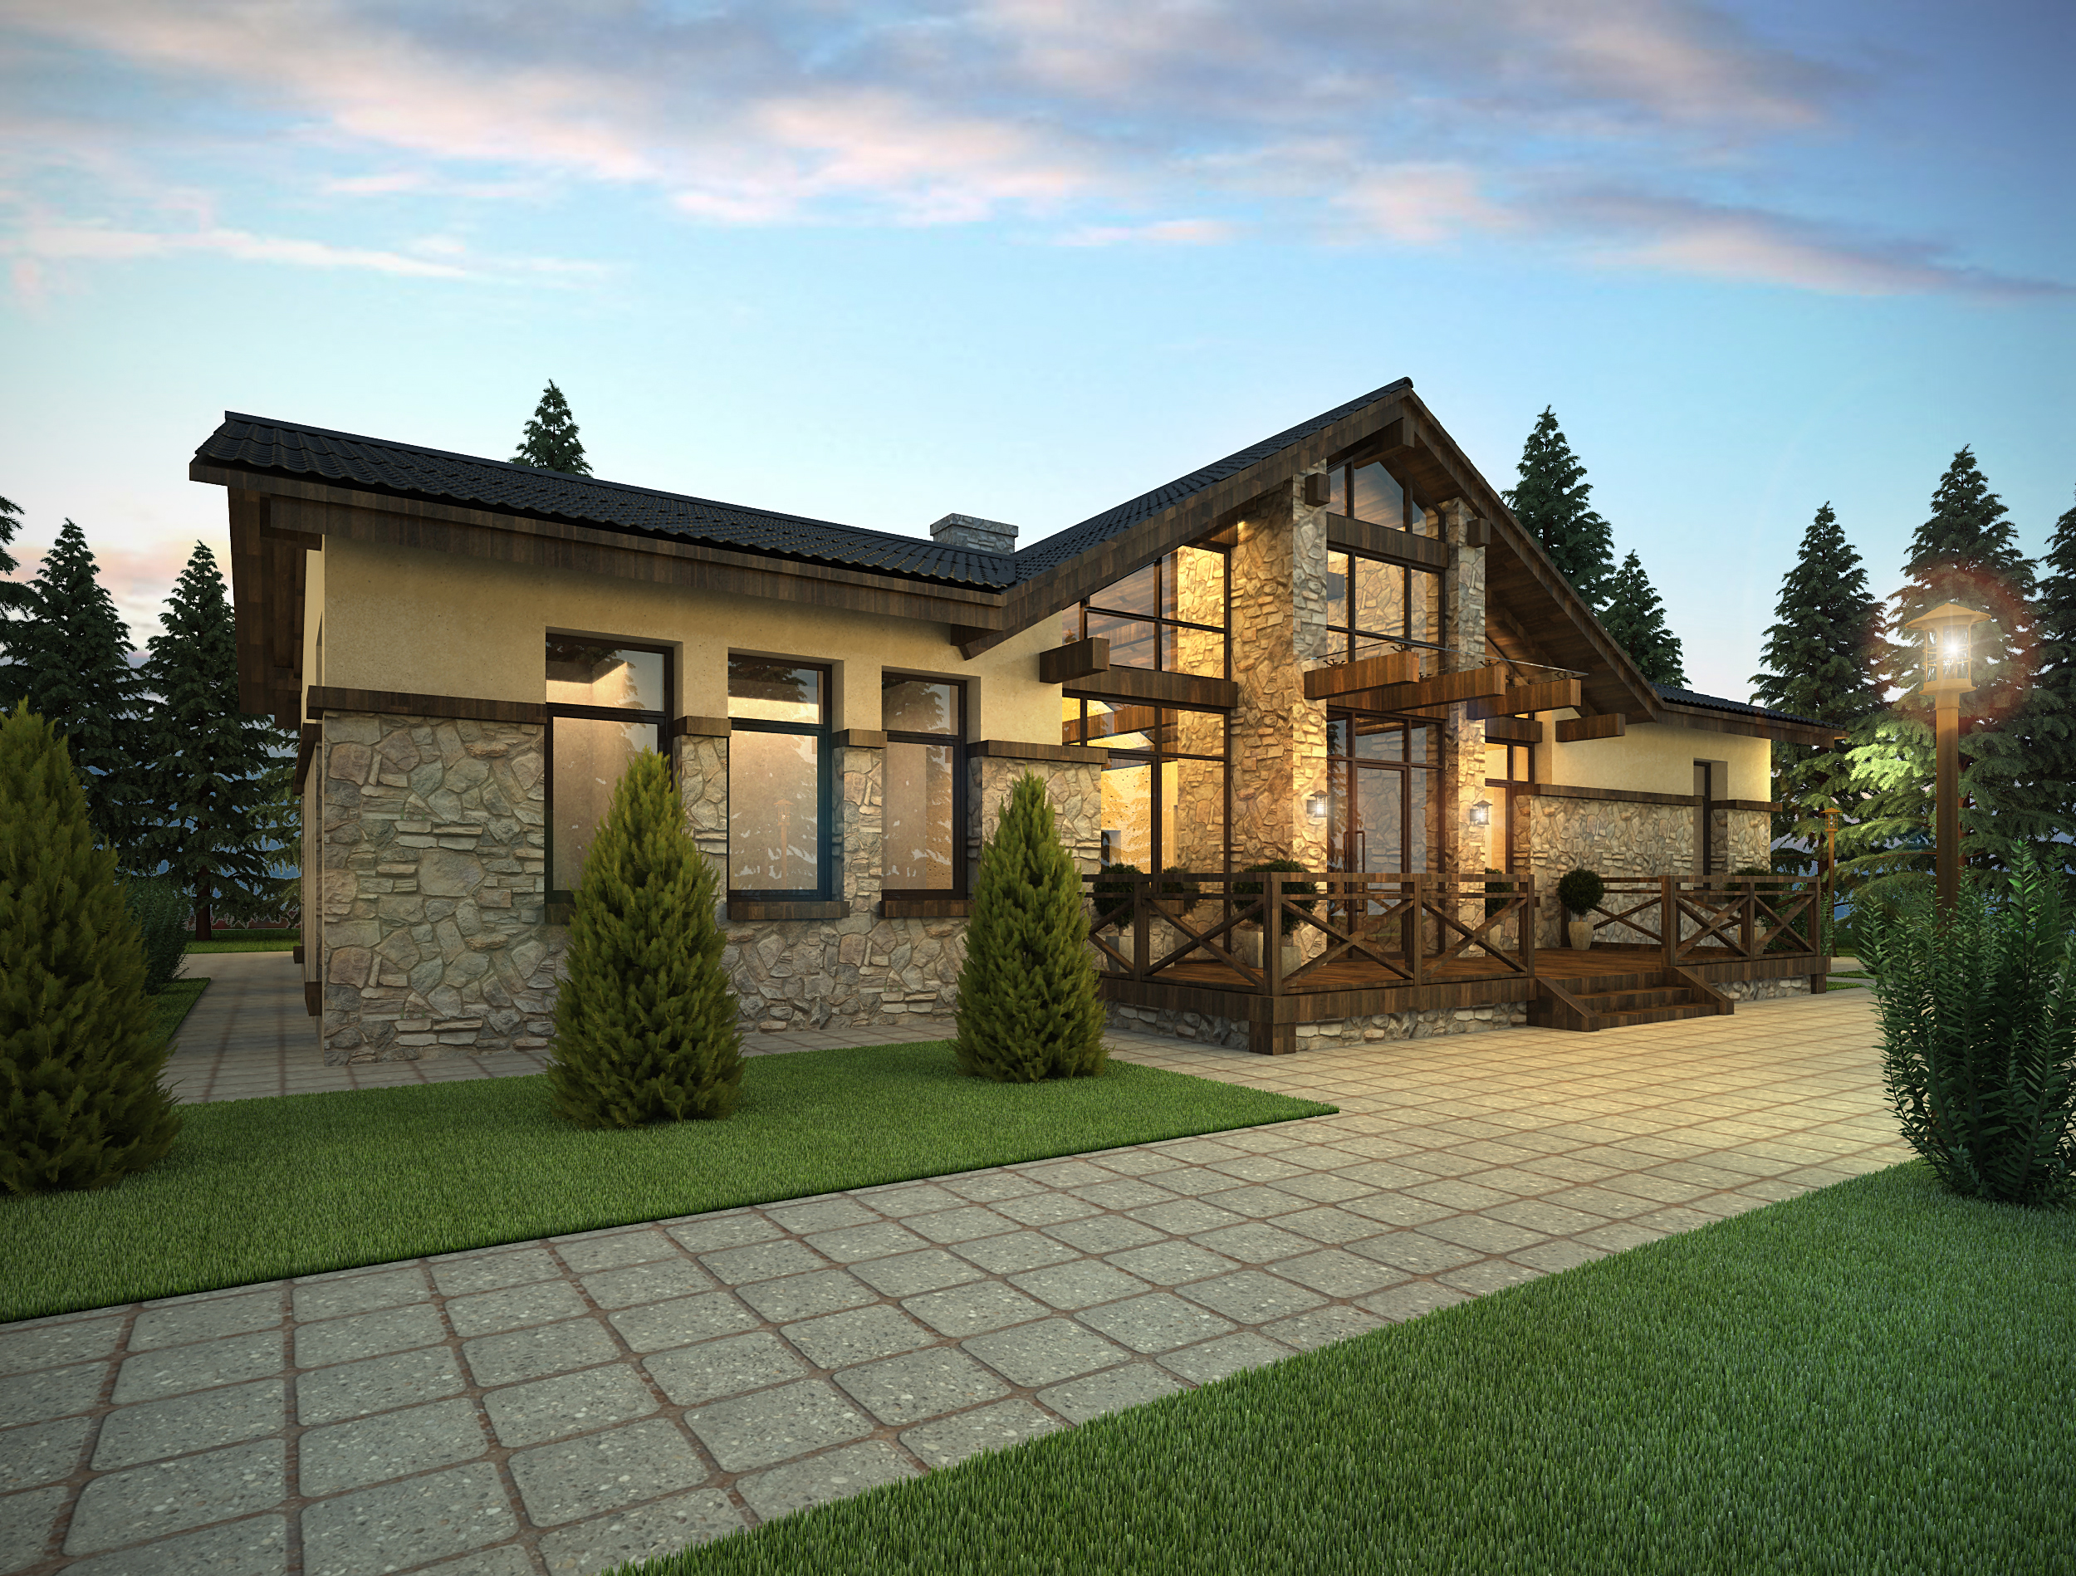
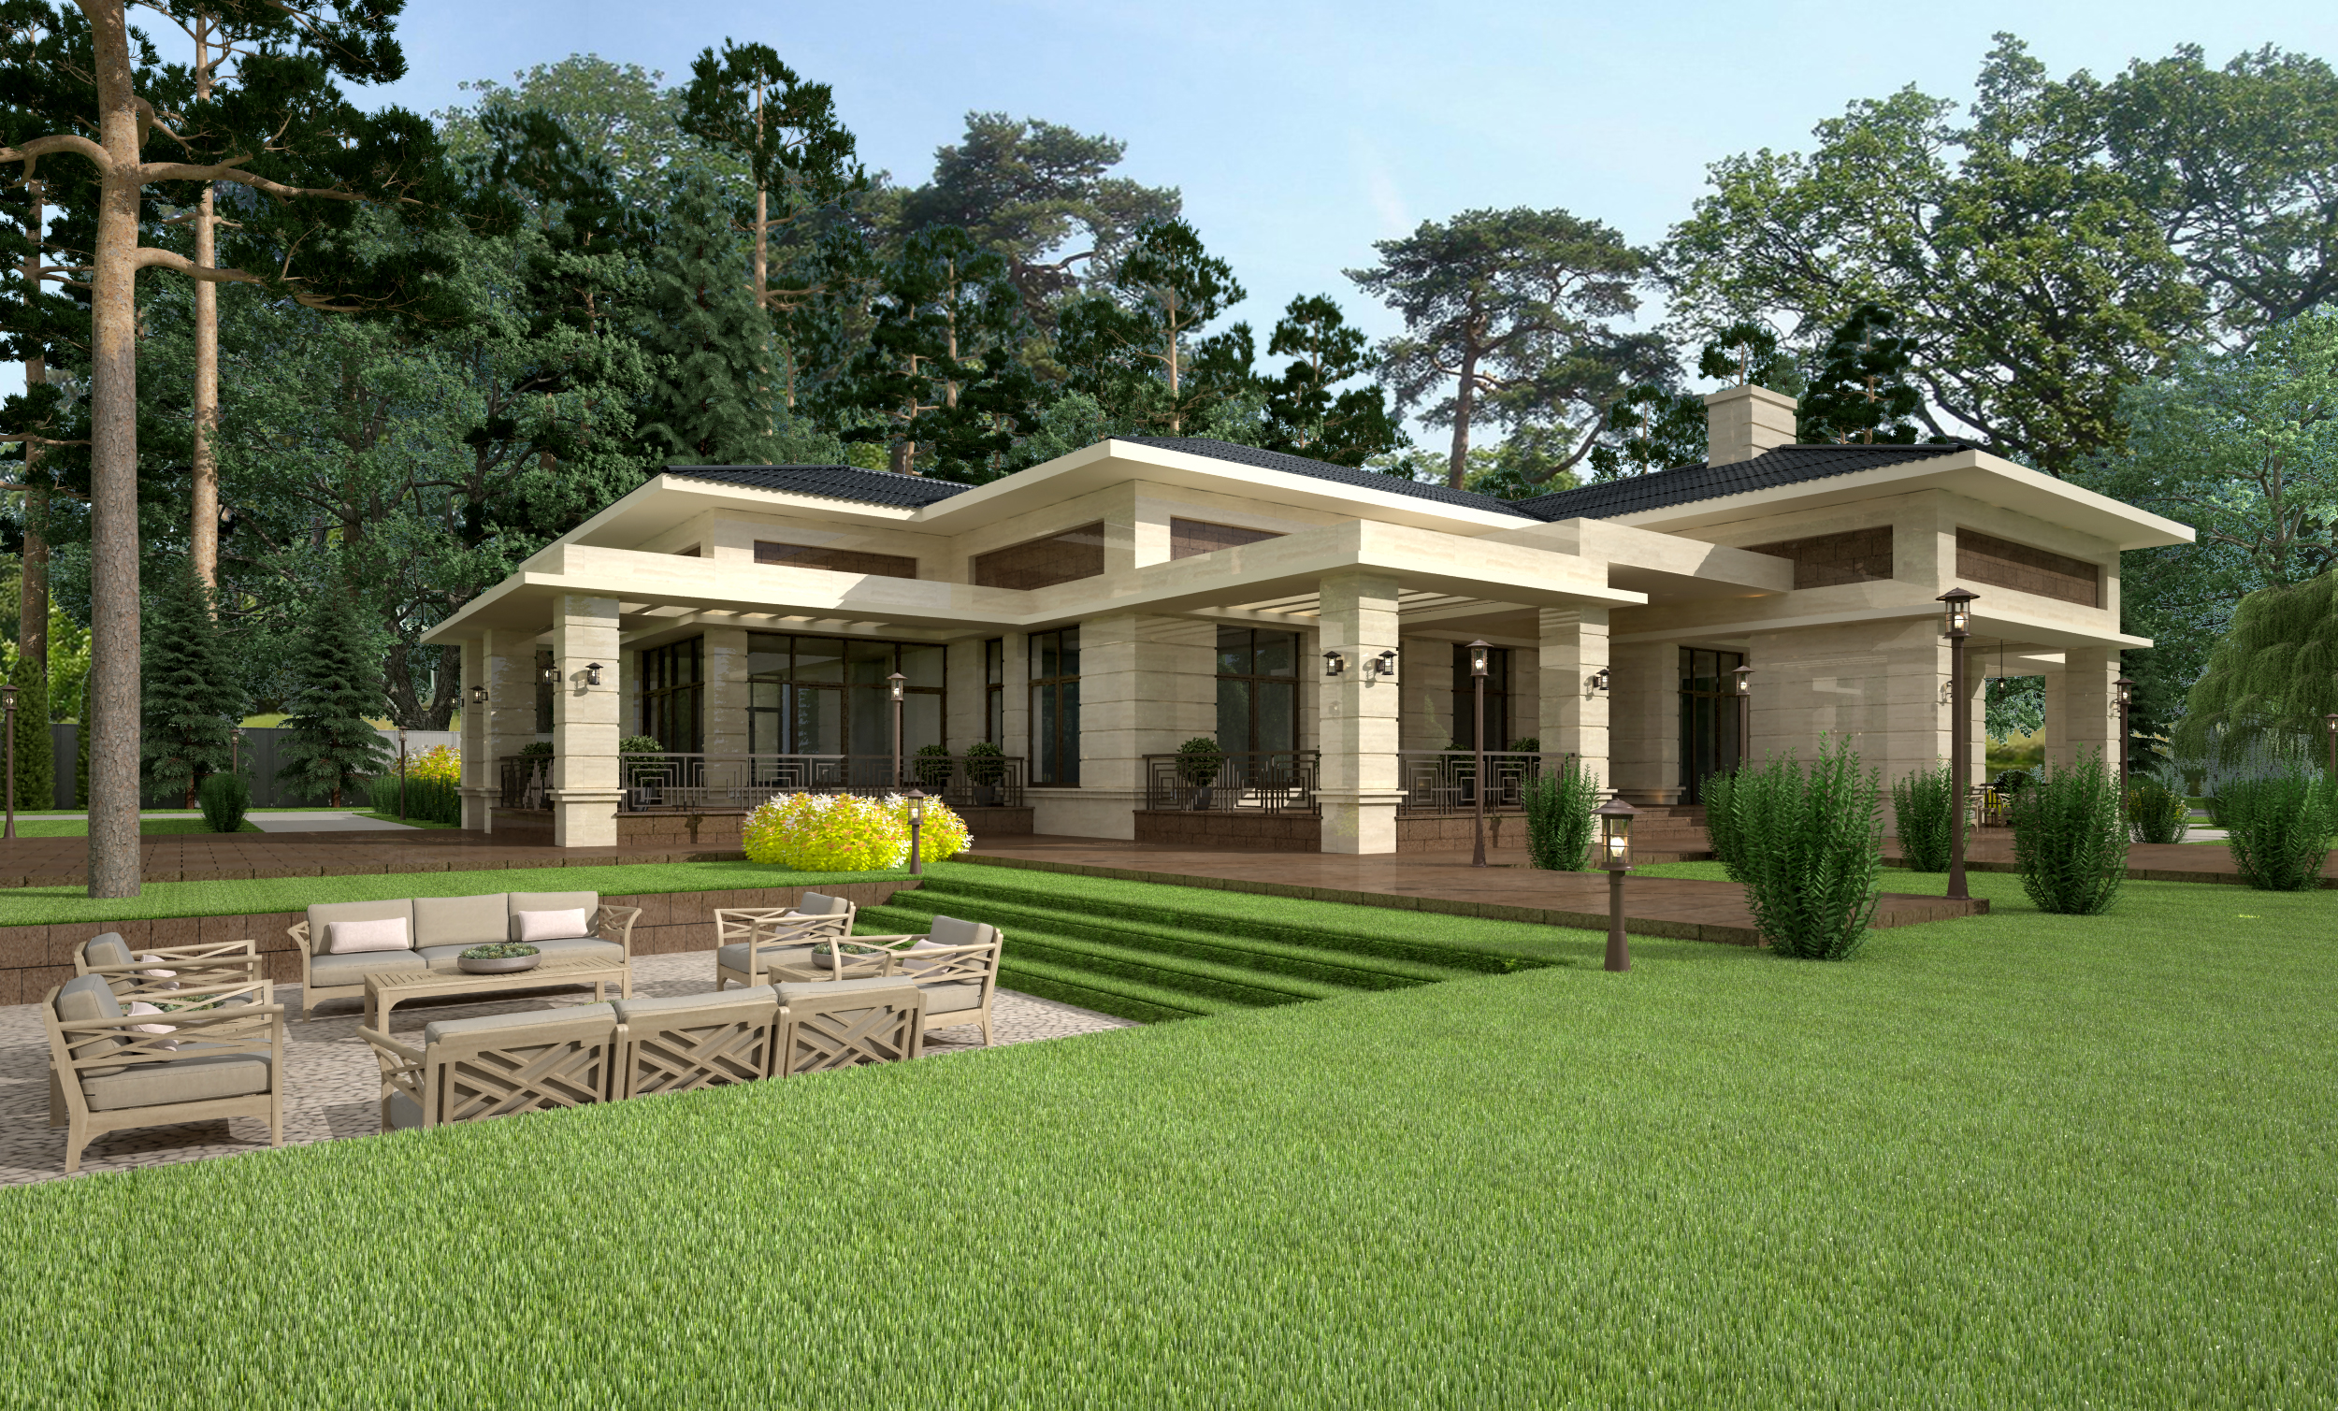
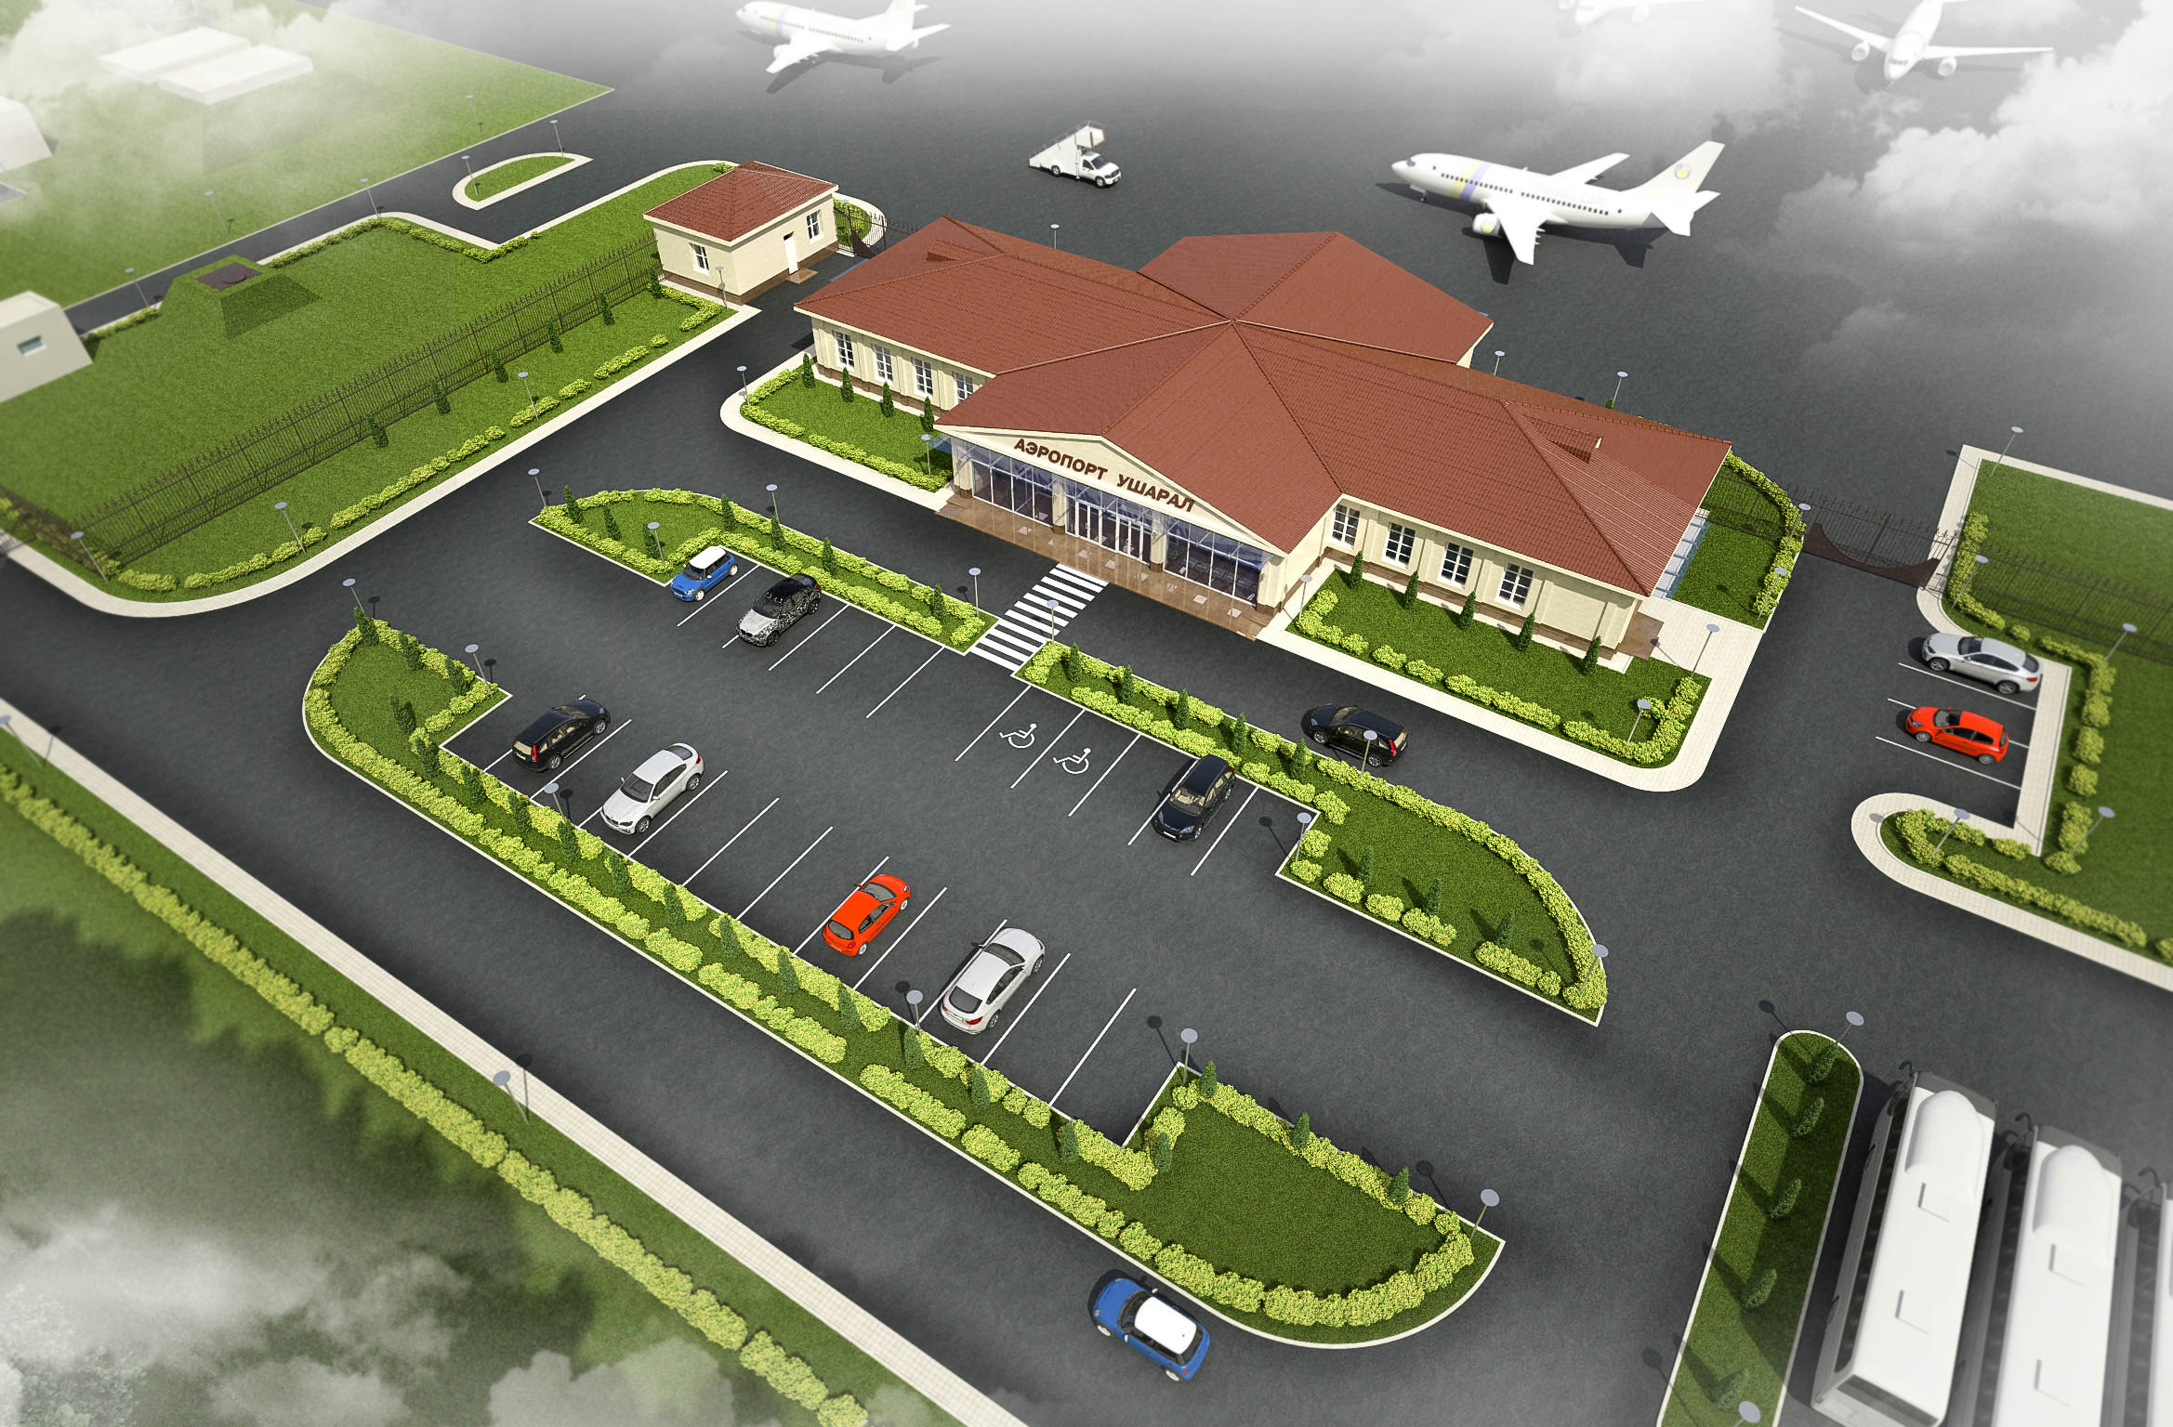
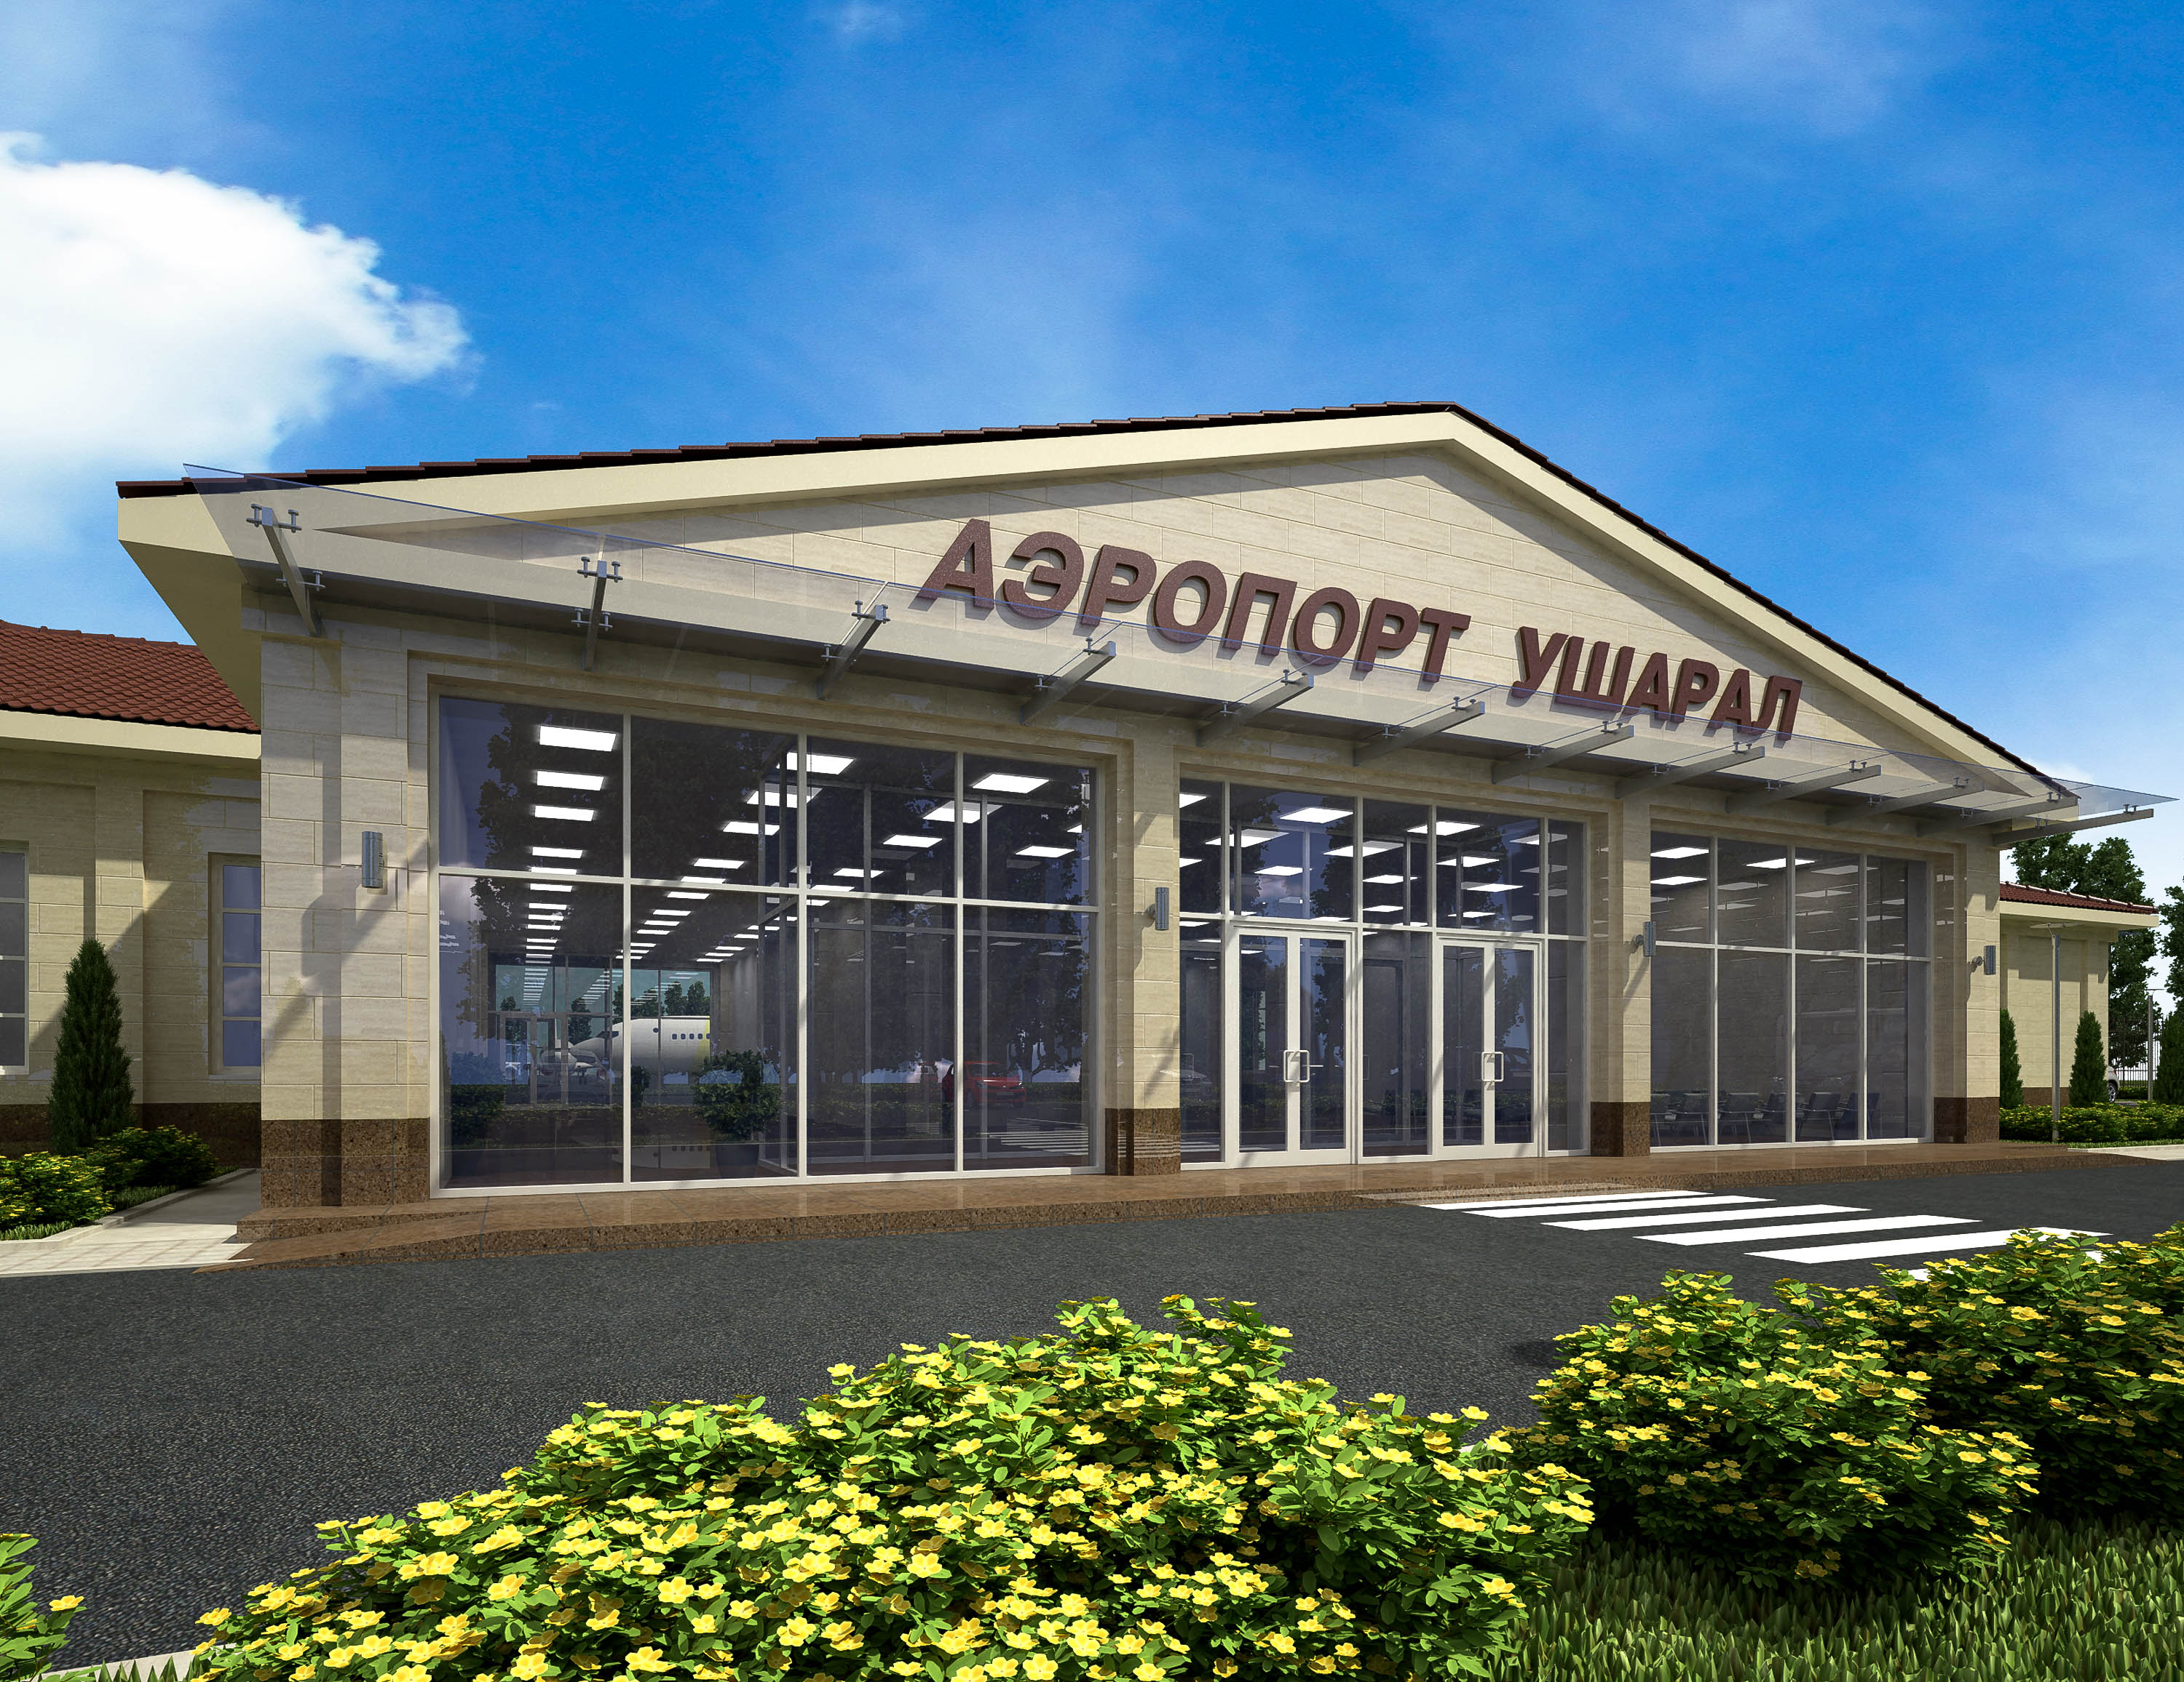
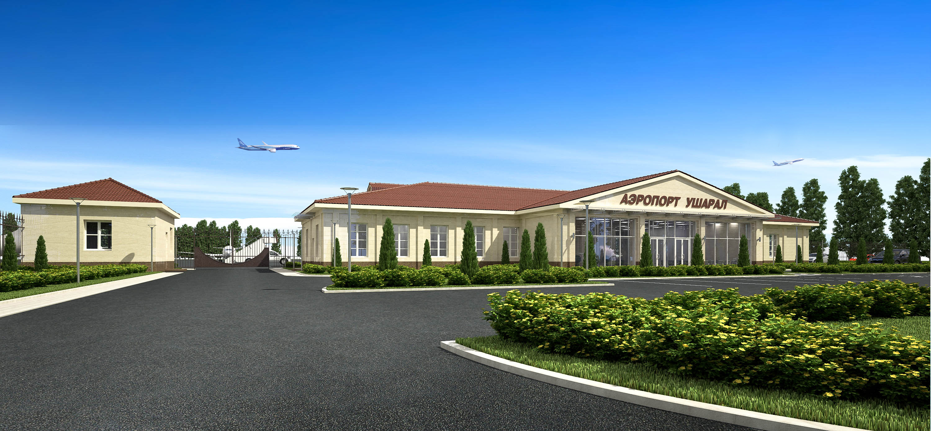
PROJECTS
TWO RESIDENTIAL BUILDINGS IN TALDYKORGAN CITY AKIM’S OFFICIAL RESIDENCE
AIRPORT TERMINAL OF USHARAL CITY IN ALAKOL DISTRICT
KAZAEROPROJECT

Slide 10
PROJECTS
Reconstruction of International Airport of Astana
Overhaul of two runways with artificial cover in Almaty International Airport
Reconstruction of Aktobe International Airport
Reconstruction of Shymkent International Airport
Reconstruction of Kostanay International Airport
Reconstruction of Kokshetau International Airport
Reconstruction of the airdrome in Almaty International Airport
Radio-navigation equipment outfit on the territory of Kazakhstan including DIA centers
Technical complex of space rocket complex "Baiterek"
Administrative housing and utility complex of SRC "Baiterek"
Aviation and technical complex in Astana airport
Equipment of the airdrome of Almaty city airport by landing system of IIIB category
An office building in Astana ("Kazaeronavigatsia" RSE)
Administrative building in Kyzylorda (PETROKazakhstan)
Reconstruction of International Airport Osh (Kyrgyzstan)
Reconstruction of the airdrome of airports of Taraz, Uralsk, Semey
Iimplementation in the national civil aviation world’s geodetic coordinate system WGS-84
KAZAEROPROJECT

Slide 11
ABOUT US
The team of Kazaeroproject has come a long way of formation and development, and for more than 40 years, addresses issues and makes decisions providing safety and successful operation of airfields. Most of the staff working today were the pioneers of ambitious but successful projects implemented today in the Republic of Kazakhstan and abroad.
Number of staff employees of Kazaeroproject is 53 people, including administrative and managerial staff - 6 people, technical staff - 37 people, support staff - 10 people.
All the works performed by the Institute, are provided by the main asset of our company - highly skilled specialists-designers 21 specialties for all types of construction design, with broad knowledge and extensive experience in the field of engineering and consulting services, which allows us to perform the full range of services - from engineering research until the completion of projects and feasibility studies in the transportation, industrial, housing and civil construction and other fields.
Knowledge and experience of our experts and their competence and professionalism, integrity and organizational skills have earned well-deserved recognition of pilots of Kazakhstan, as well as the design and engineering society of the country.
KAZAEROPROJECT

Slide 12
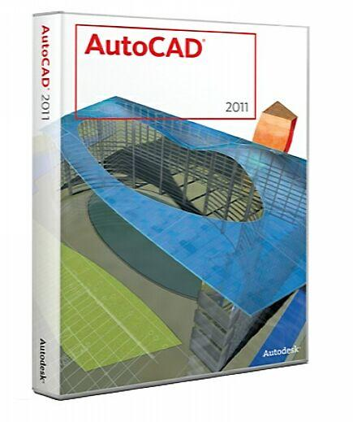
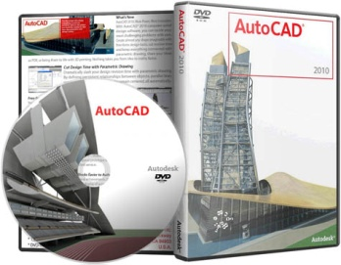

OUR CAPABILITIES
Design at the Institute is carried out using the latest computer-aided design systems and software, which ensures a high level of design and estimate documentation.
Software list:
AutoCAD 2010;
- AutoCAD Revit Structure 2009;
AutoCAD Revit Architecture 2009;
AutoCAD Revit MEP 2009;
AutoCAD Civil 3D 2009;
CREDO MIX;
CREDO DAT;
- R-WAY.
Modern copying machines
Provide customers required number
of high quality project documentation.
KAZAEROPROJECT

